Slide 1
Salary Prediction Cleaning
By: Spencer Reno

Slide 2
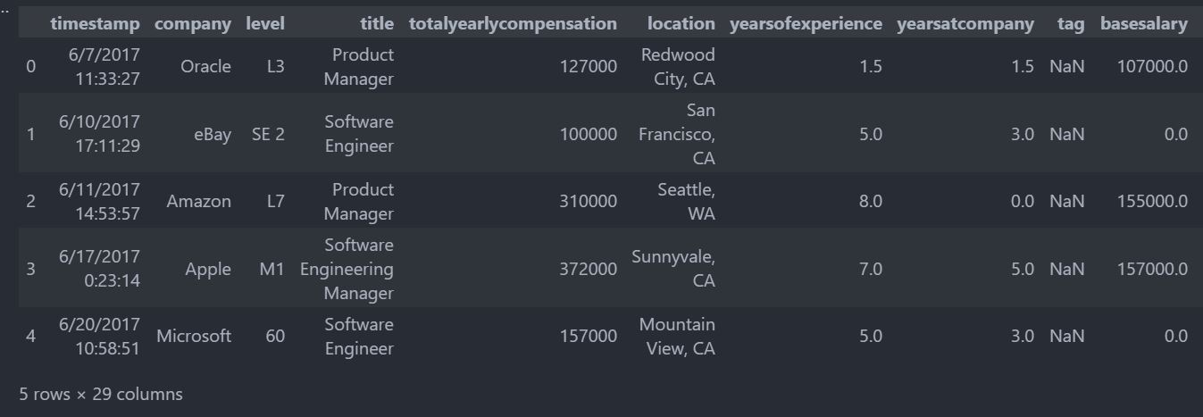
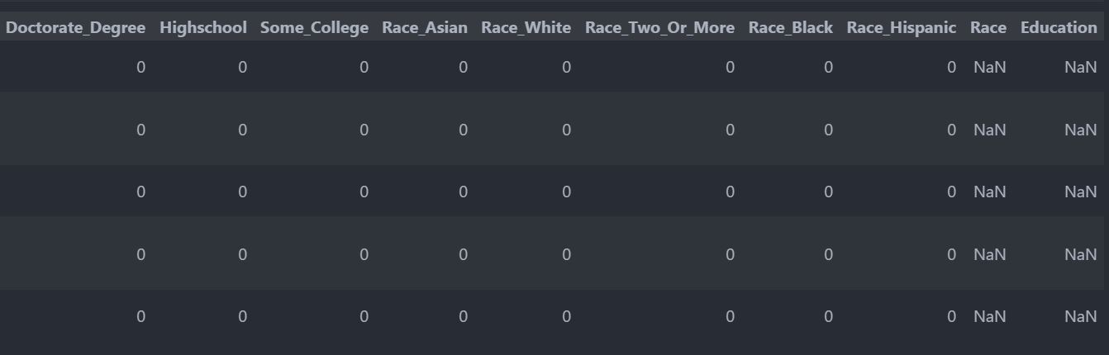

Slide 3
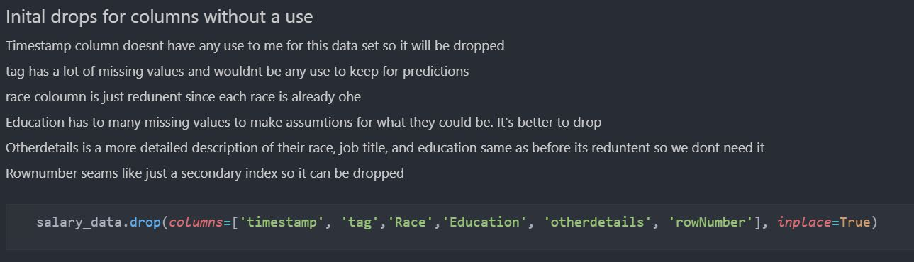
Looking at the base data there were some columns that aren’t really needed for the task at hand. Timestamp was dropped as I won't be doing any time tracking for visualizations, and this will be useless for predictions. The tag column had a lot of missing values and trying to replace wouldn’t add any value to our predictions. The race and Education columns were dropped since they both had a lot of null values and already had correlated one hot encoded columns within the dataset. Otherdetails and RowNumber were redundant columns with information already specified else where in the data.

Slide 4
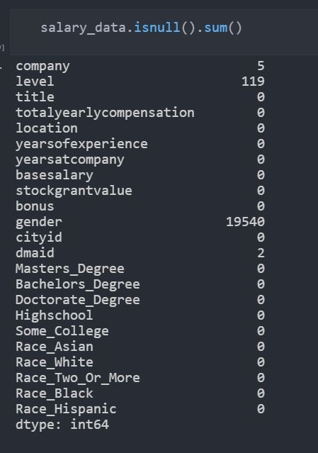
There were a lot of data points that were missing within this data and were handled after this point in many interesting ways.

Slide 5
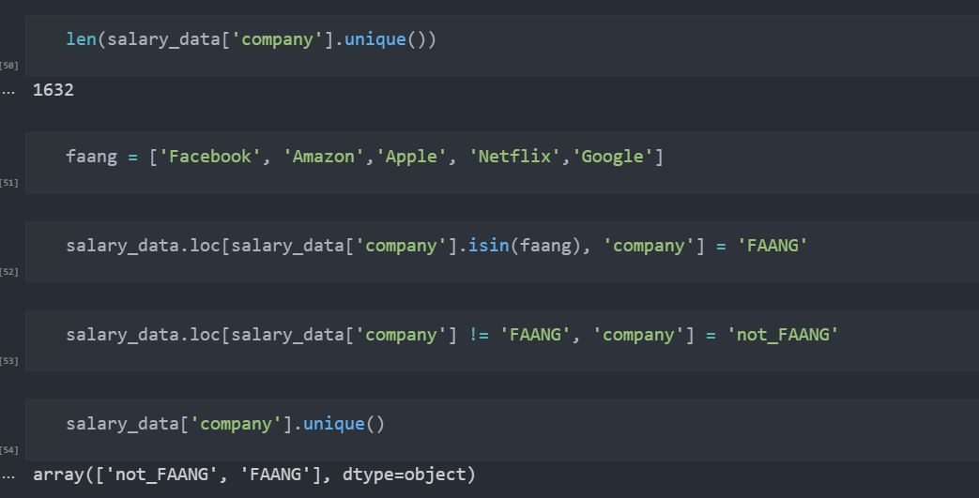
Looking at the company column at first it was just 5 missing data points. However, after looking deeper into the data within the column I seen there were 1632 different companies and this would be very difficult to determine how to handle these missing values. After comparing different ways to combat this my final choice was to compare all the data based on FAANG companies (Facebook, Amazon, Apple, Netflix, Google) vs non faang companies. This was done by renaming all the FAANG companies to FAANG and the others to non_FAANG.

Slide 6
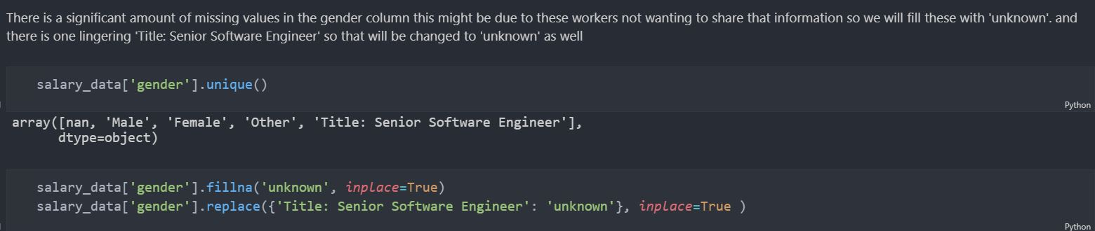
There is a significant amount of missing values in the gender column this might be due to these workers not wanting to share that information, so I thought it was best to be filled with 'unknown’ rather than assuming. Also, there is one lingering 'Title: Senior Software Engineer' so that was also changed to 'unknown’.

Slide 7
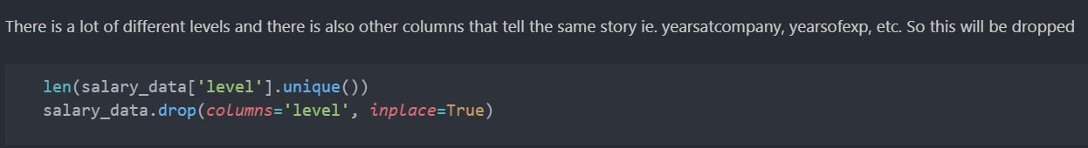
With the levels column this was focused on trying to specify a worker's job position or ‘level’ at the company. There was however other columns within the data set that told a similar or same story/idea. So, to limit the redundancy this column was dropped.

Slide 8
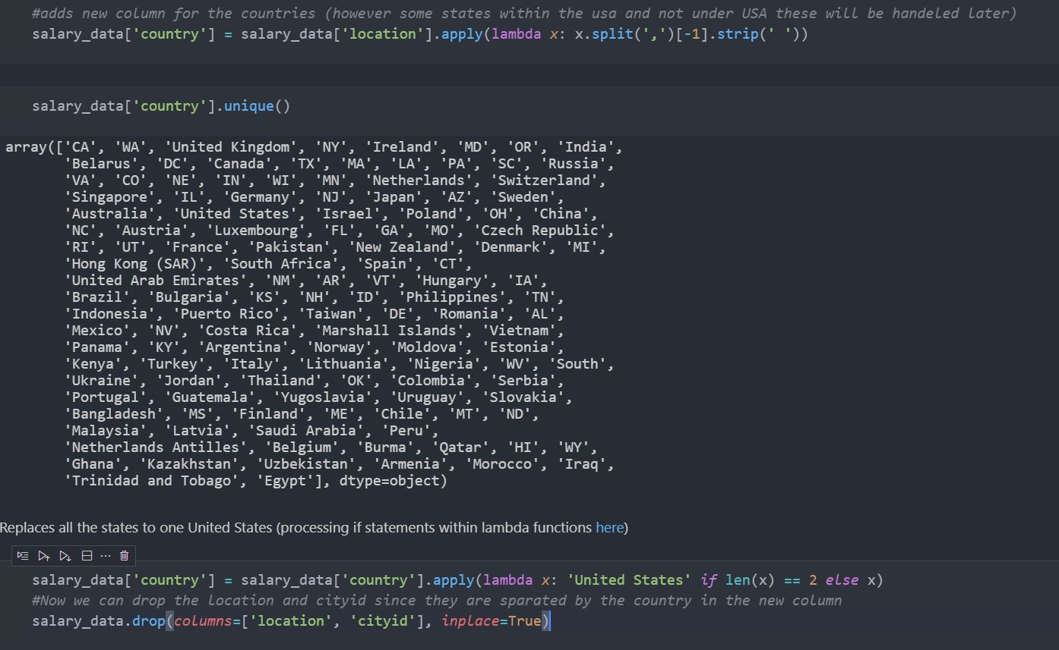
With in the location column the states were specified with City State, but other countries were just listed as their country. So, with reverse indexing you could obtain the country and for any united states that weren’t specified with 3 values it would just give the state abbreviation. After making that new column and using a lambda function to specify if the value within the new column was of the len of 2 aka a state abbreviation and to replace it with the str of United States. After all the previous steps this led to having the country column list all different countries within the data. Now that we have this column the location and cityID columns are no longer needed and were dropped.

Slide 9
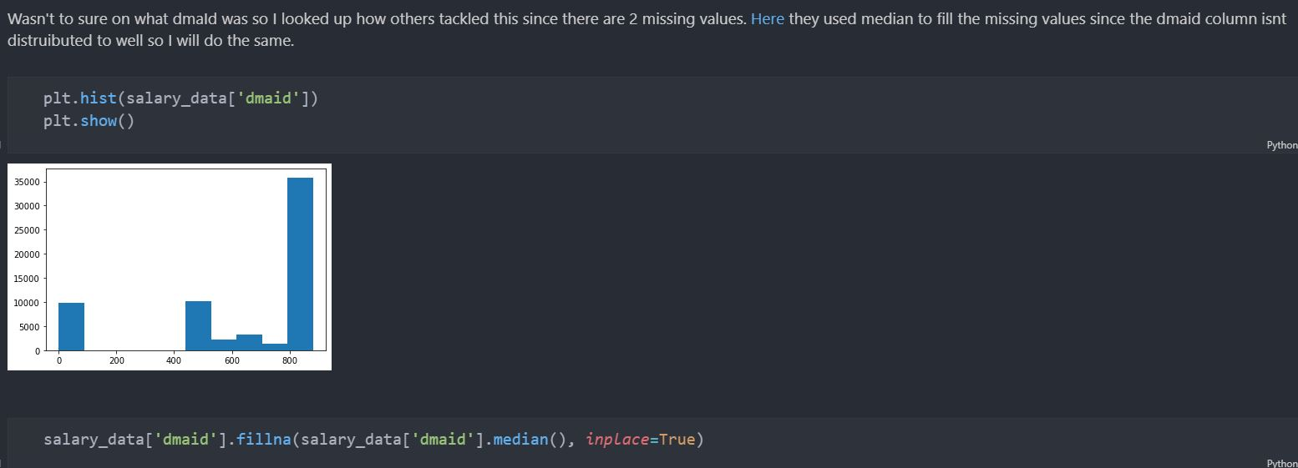
The final column with a missing value was the dmaid. At first, I wasn’t sure of what dmaid was so after research I found how others have combatted this within the data and found that they used median to fill the missing values to help with the gap within the hist plot of the column.

Slide 10
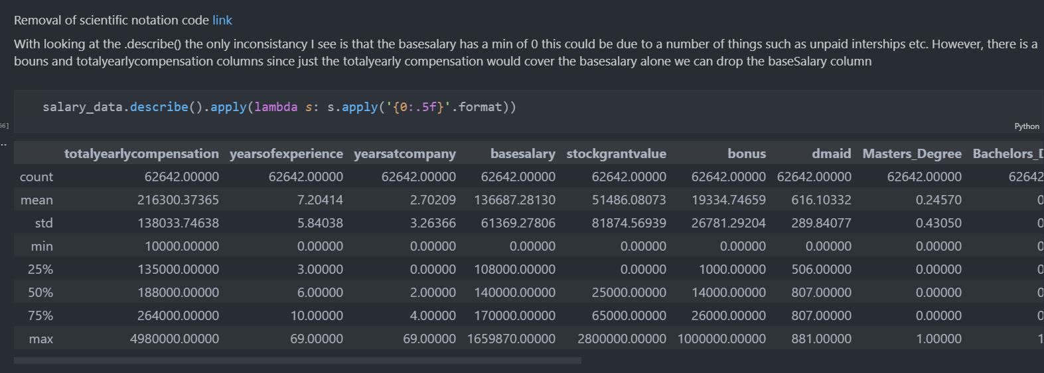
After handling all the missing values looking at the describe() of the dataset there were two inconsistencies that stood out. One was that basesalary was a min of 0. This could be due to several things such as unpaid internships etc. However, there is a bonus and totalyearlycompensation columns. Since just the totalyearlycompensation would cover the basesalary alone we can drop the baseSalary column. The second inconsistency was a major outlier in yearsofexperience and yearsatcompany of 69. Now this could be true since its only one row. However, its very unlikely that someone would stay at the same job for 69 years. I dropped this row to not skew any of our data later.

Slide 11
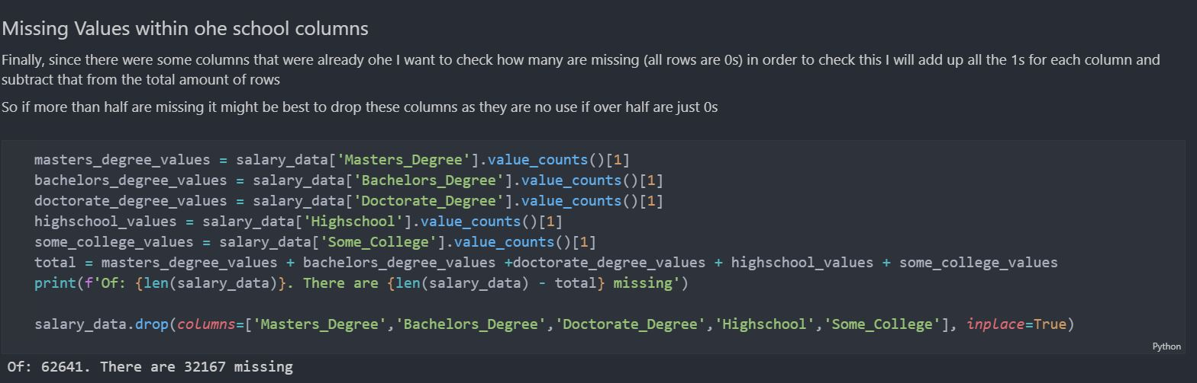
While it was nice to have columns pre ohe its still good to check them for issues. One that I did find for both sets the school and race columns was there are missing values. They might not be be NaN but they were when a all values in the row were specifying a 0. In order to check this I added up all the 1s for each column and subtract that from the total amount of rows. This showed that for both sets race and schooling more than half are missing for both. Dropping these columns doesn’t change much with a base KNN model ran in a test with all columns the run time took 6 minutes and gave a score of Training: 0.852341136615955 Testing: 0.7662578155179134. after dropping both sets of Ohe columns this improved the runtime tremendously down to 56 seconds still not great but there are other ways to fix this. Also, with dropping the columns even improved the models scores with the training going up to 0.86 and test going up to 0.78 .

Slide 12
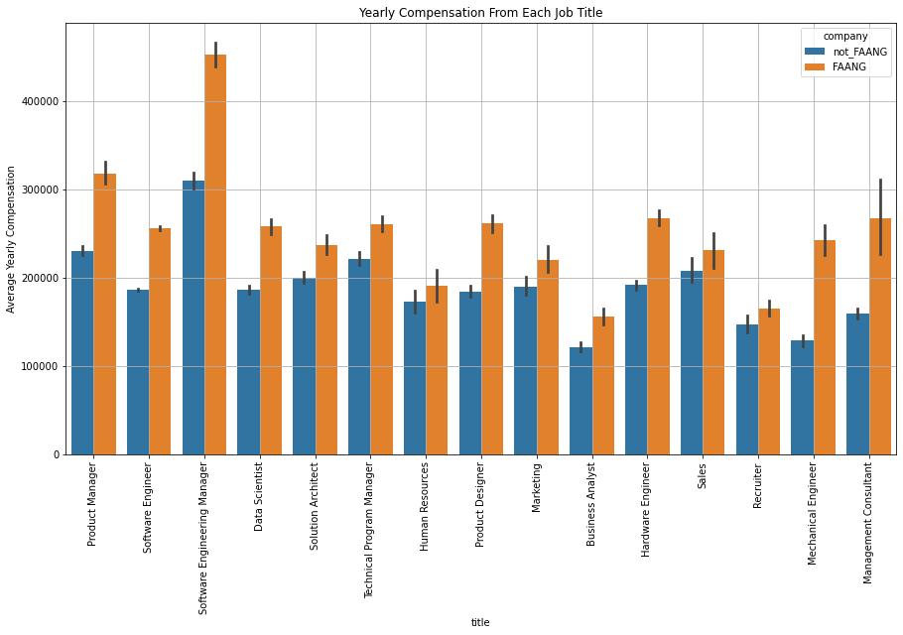

Slide 13
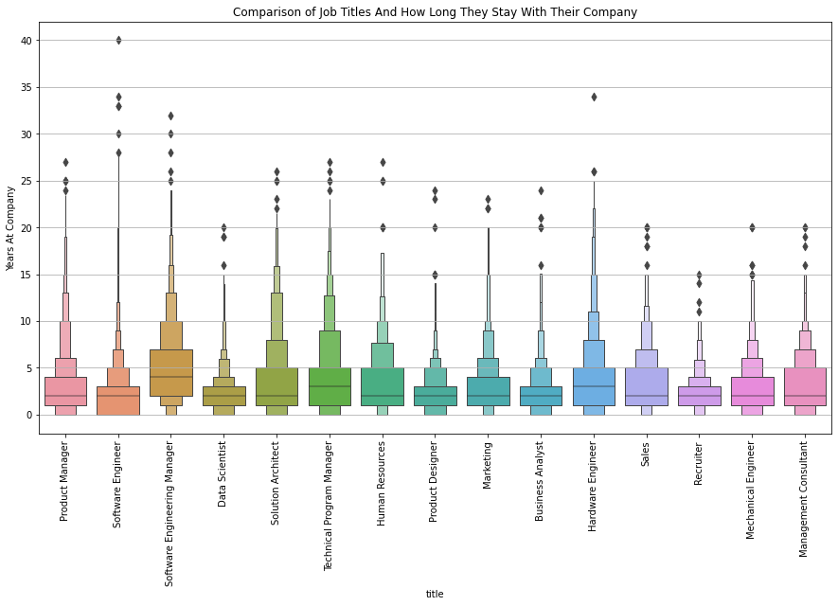

Slide 14
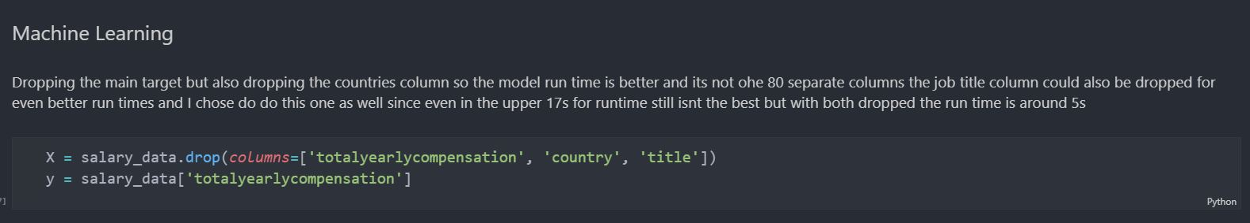
Model Preparations
While the country and title columns are nice to have for data visualizations, they increase the run times for models since it would have to one hot encode each of the 80 countries and each job title for the machine learning preparations these were dropped.

